Slide 1
Skills (Instructor)
Today’s Event

Slide 2
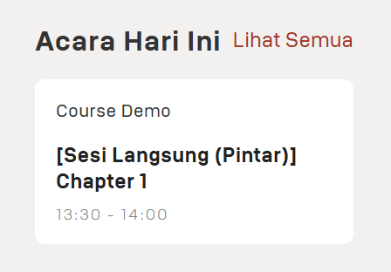
Indonesia

Slide 3
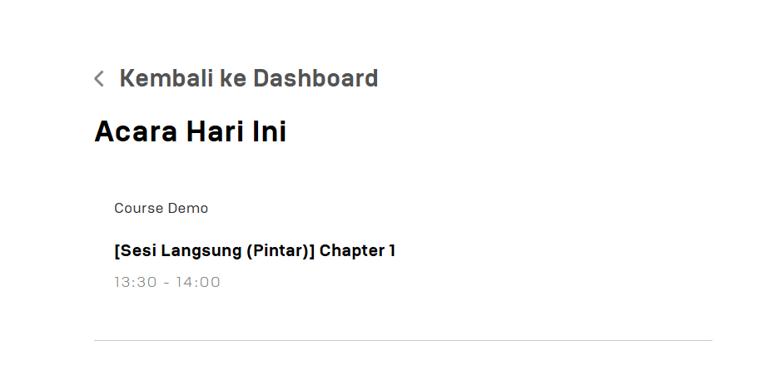

Slide 4
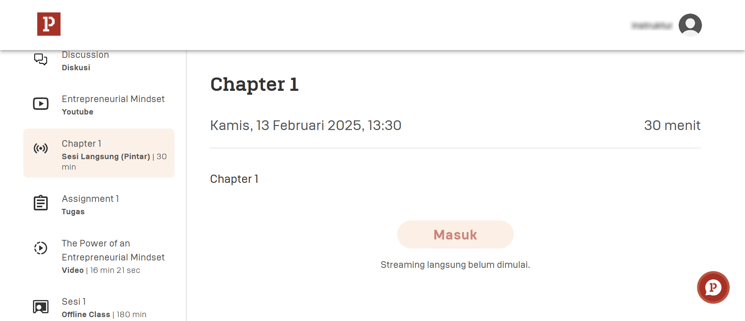

Slide 5
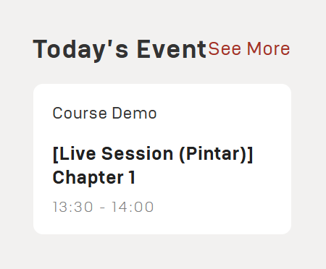
English

Slide 6
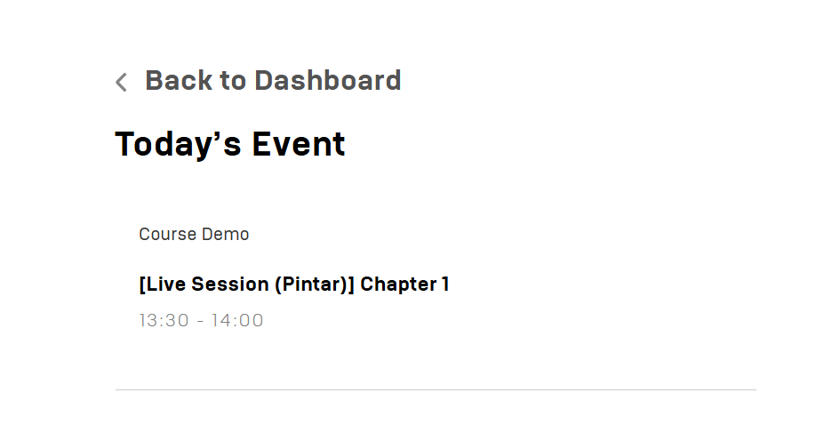

Slide 7
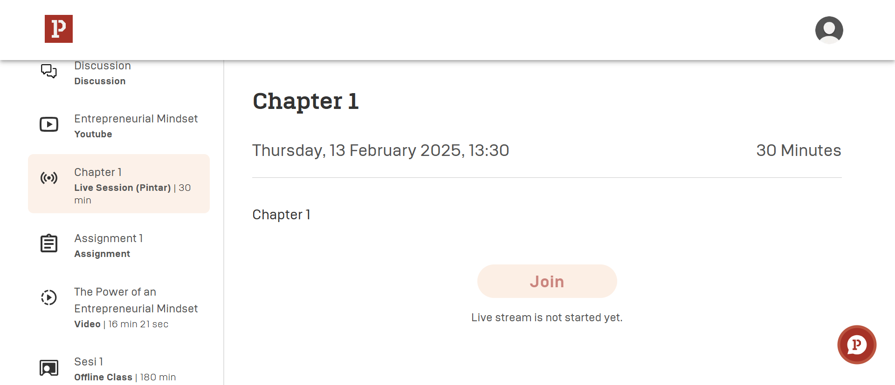

Slide 8
Skills (Instructor)
Upcoming Event

Slide 9
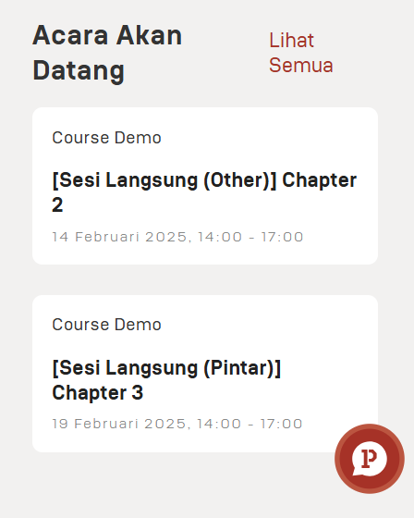
Indonesia

Slide 10
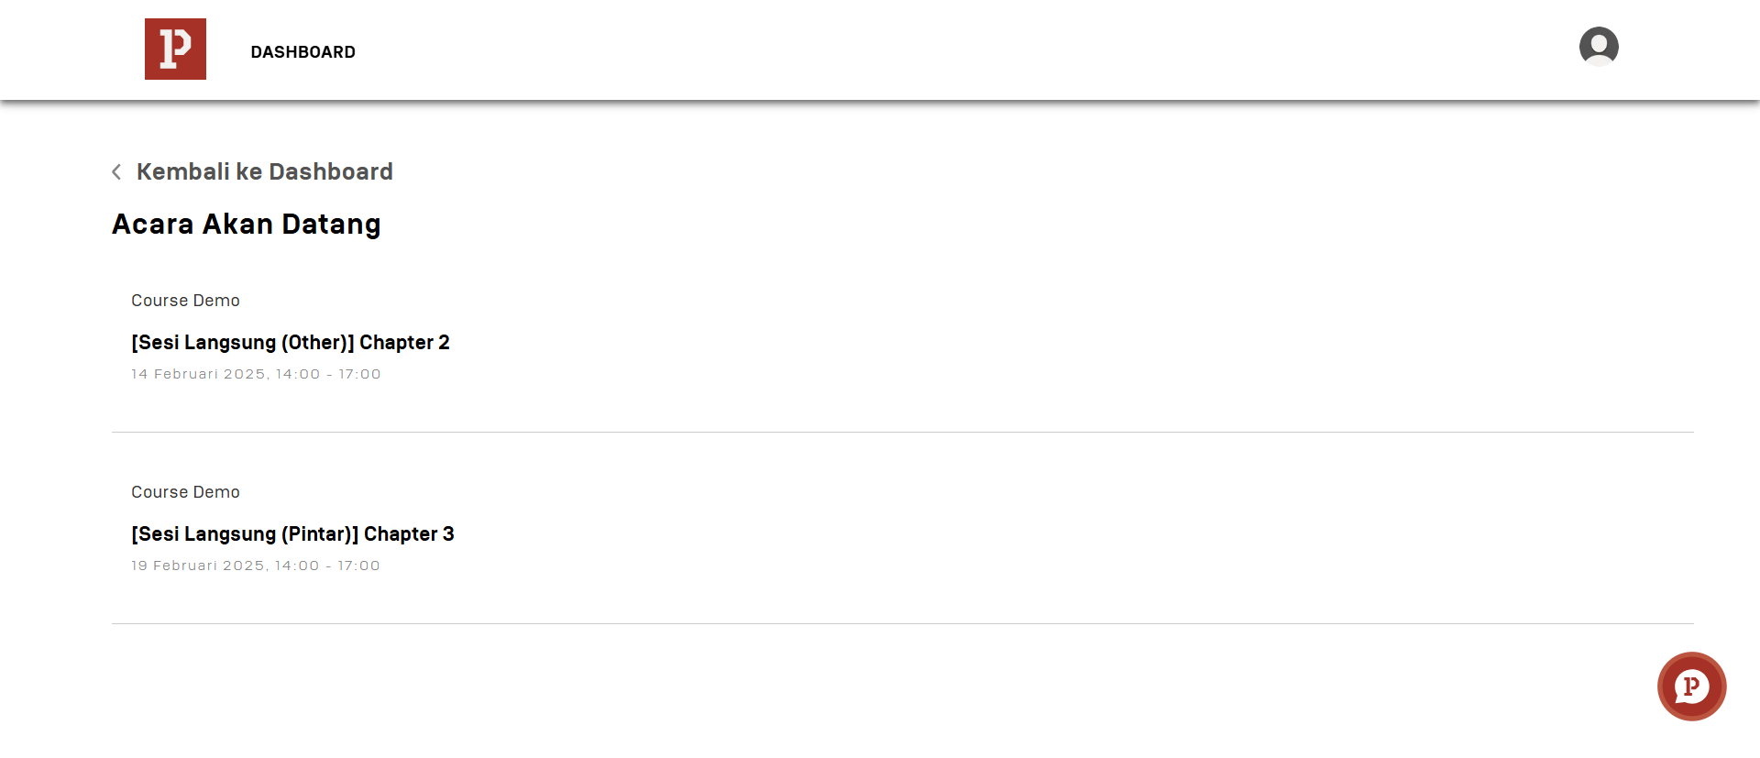

Slide 11
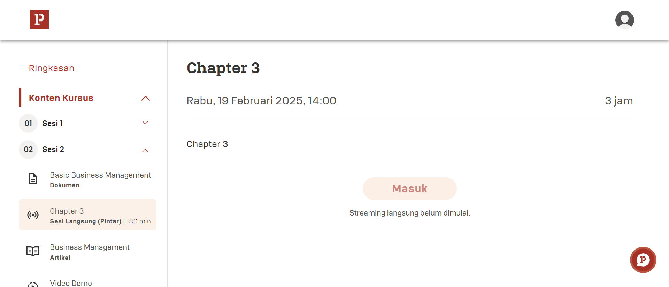

Slide 12
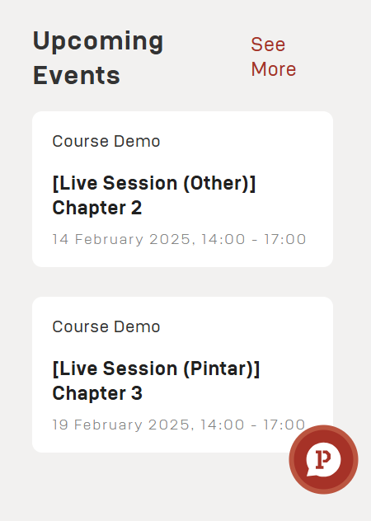
English

Slide 13
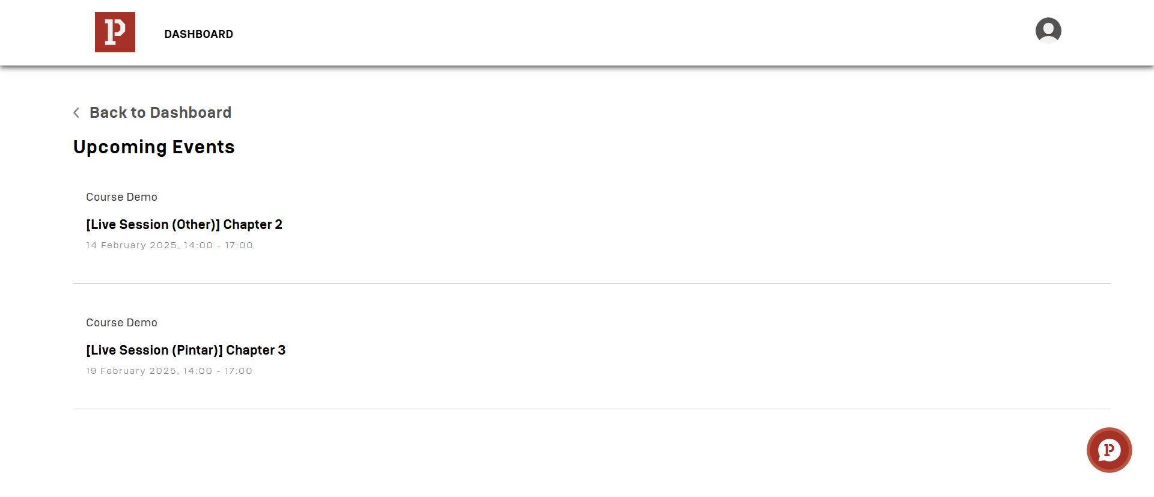

Slide 14
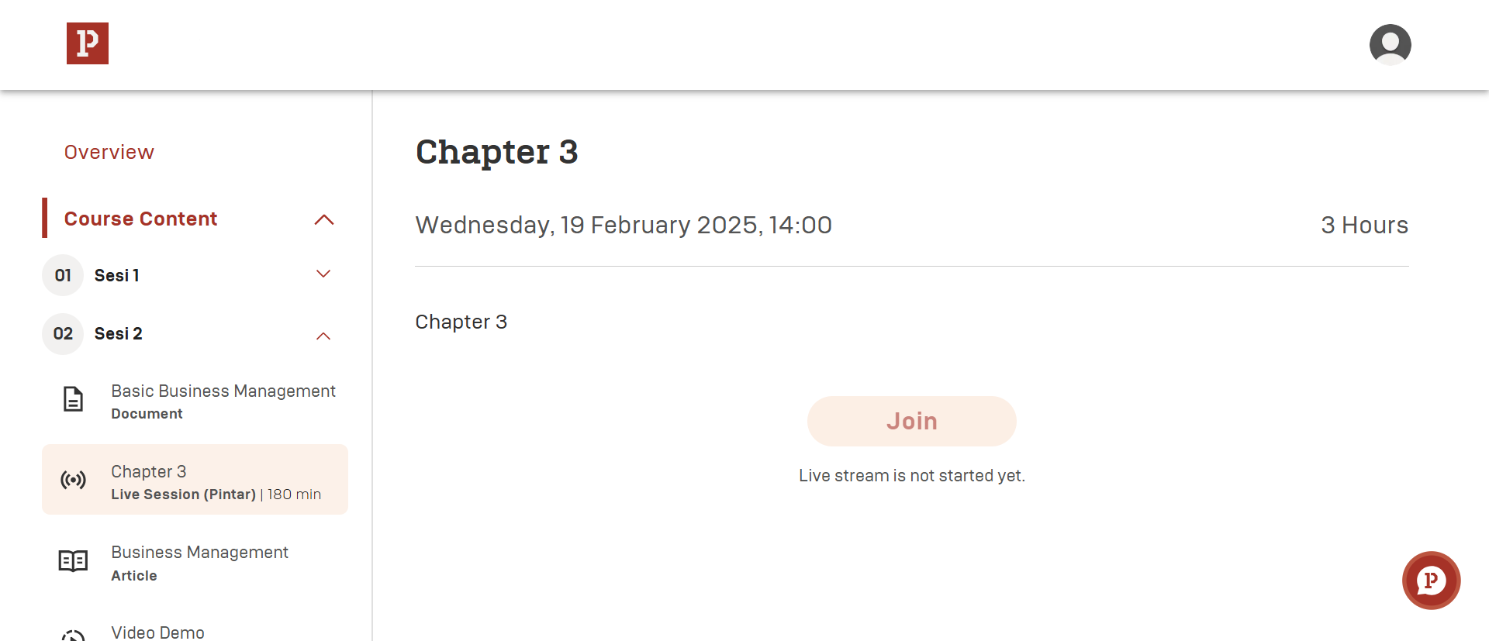

Slide 15
Skills (Instructor)
List Courses Skills

Slide 16
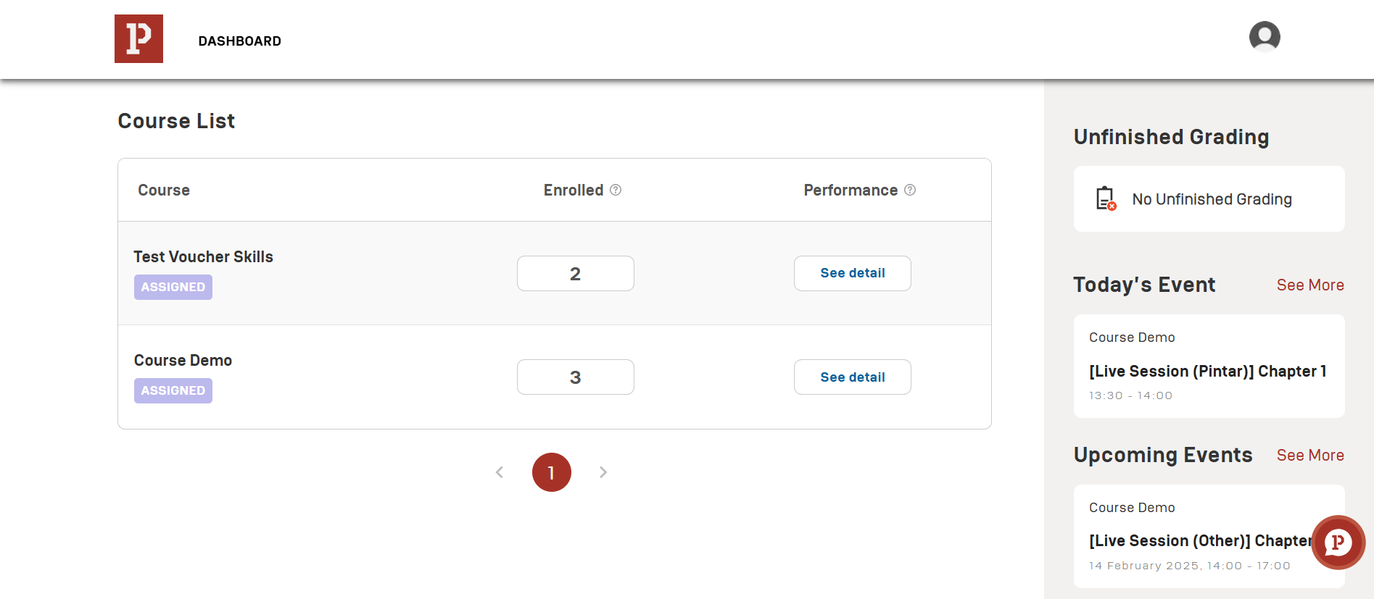

Slide 17
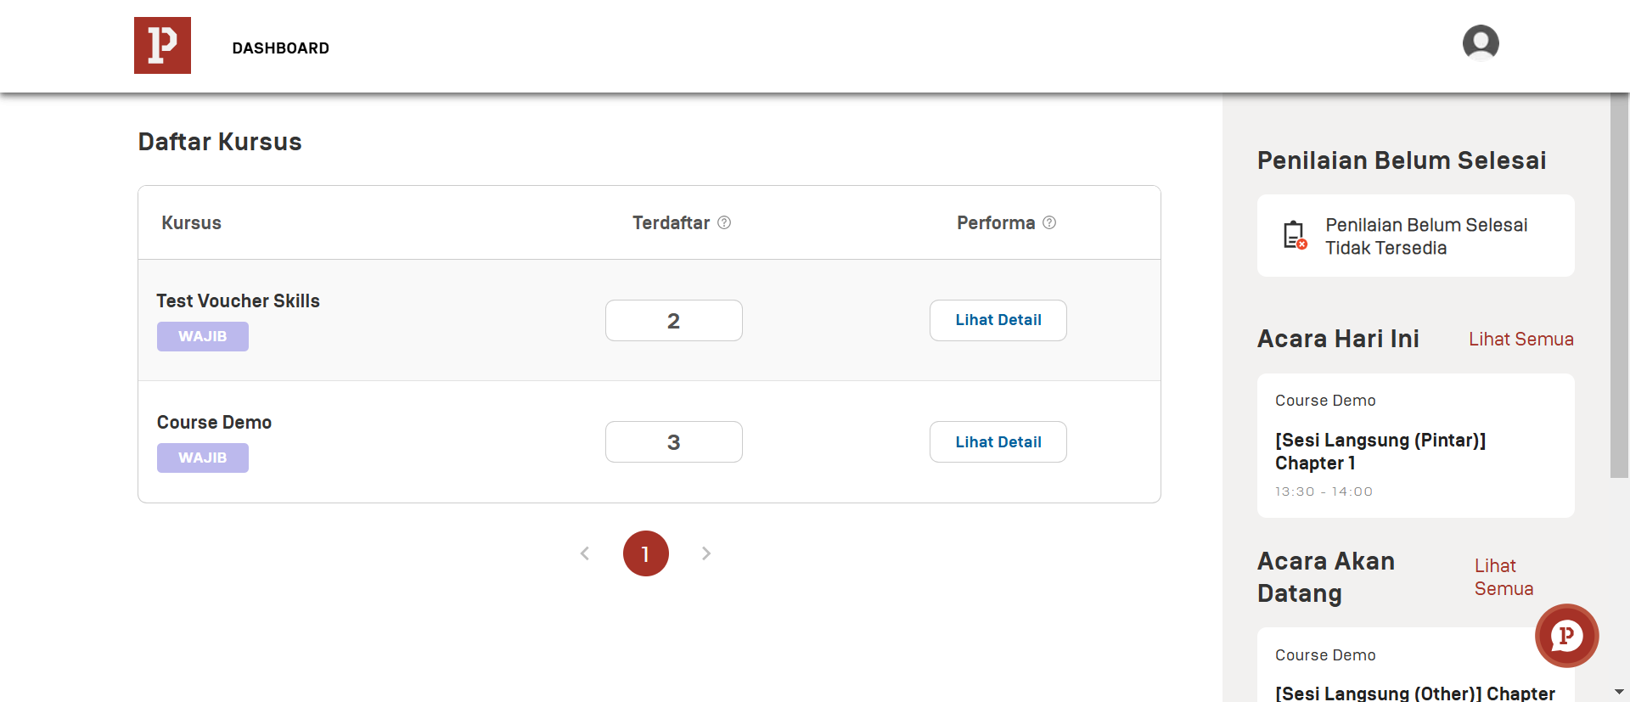

Slide 18
Skills (Instructor)
View Enrollment per Courses

Slide 20
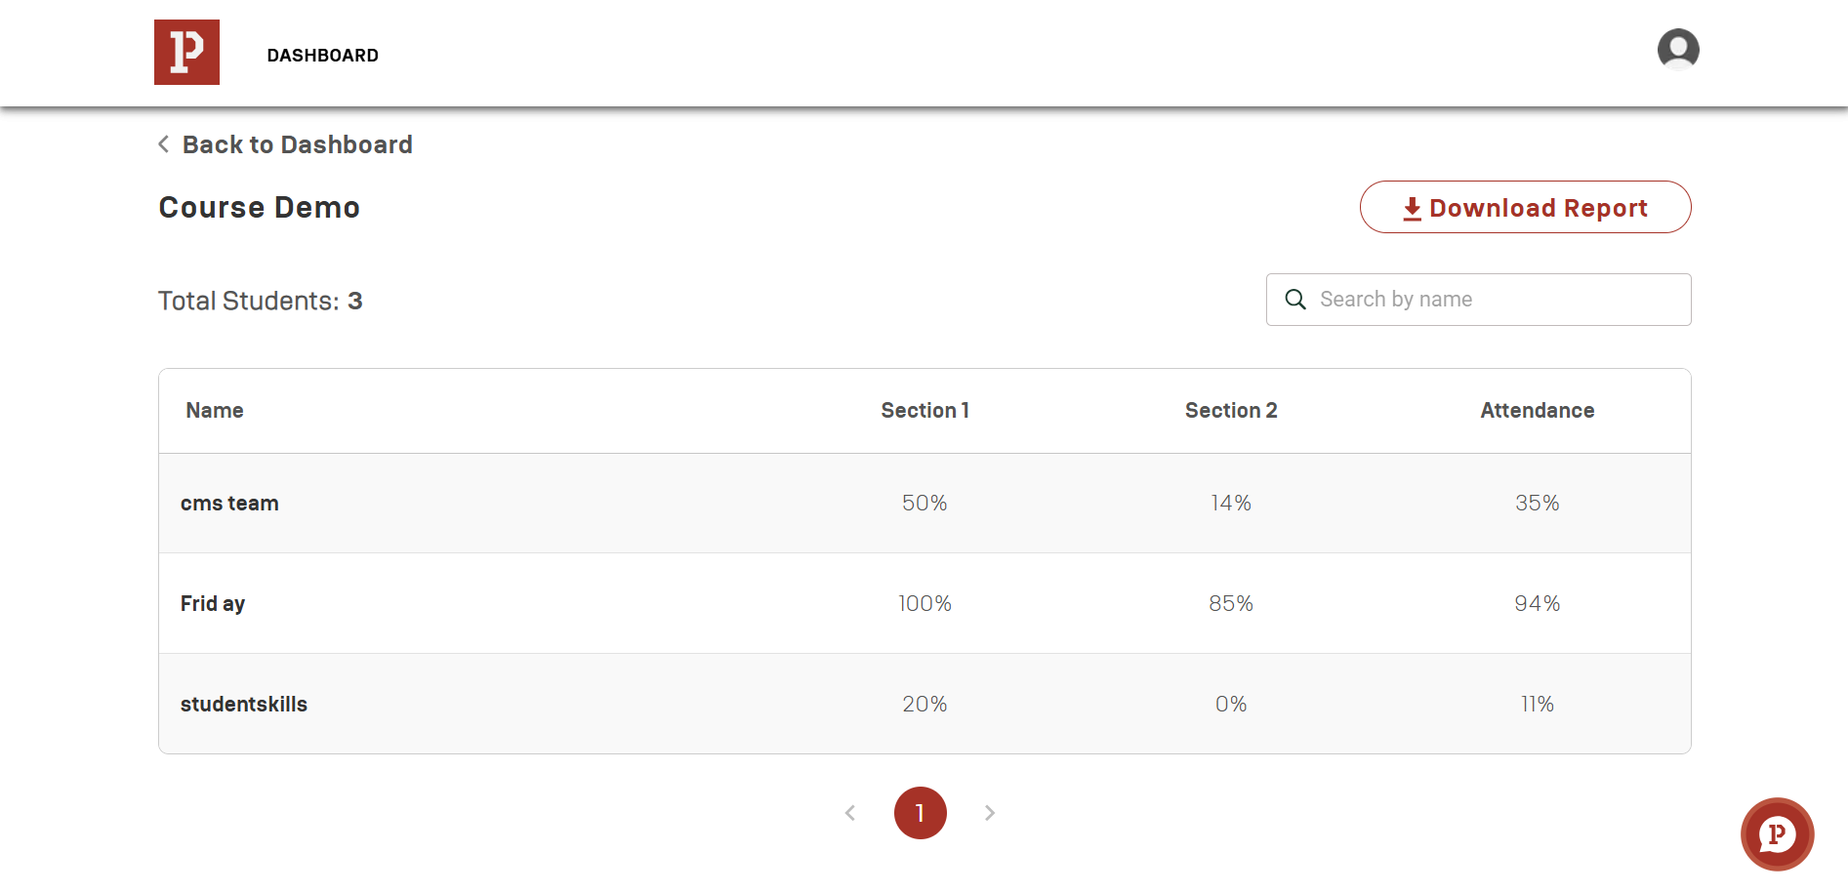
1
5
2
6
3
7
4

Slide 22
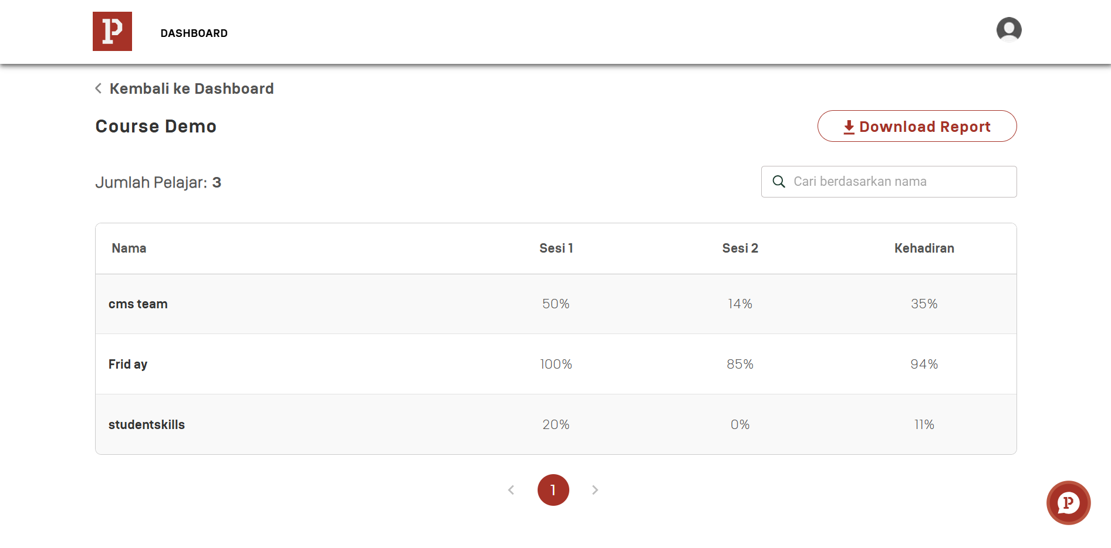
1
5
2
6
3
7
4

Slide 23
Skills (Instructor)
View Performance Learner Under per Courses

Slide 25
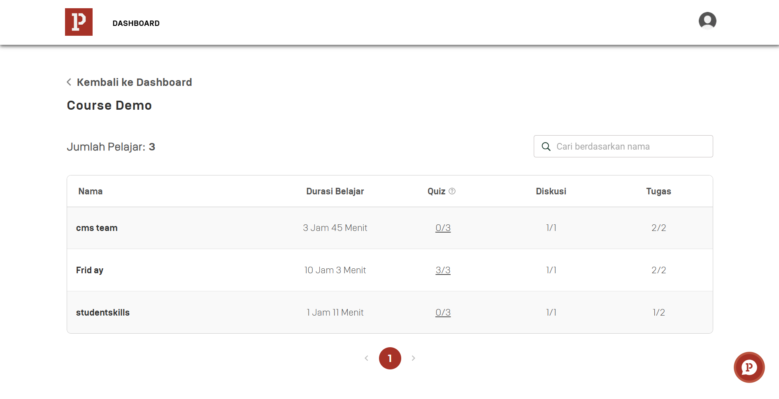
6
1
2
7
3
8
4
5

Slide 27
6
1
2
7
3
8
4
5

Slide 28
Skills (Instructor)
Description & Overview

Slide 29
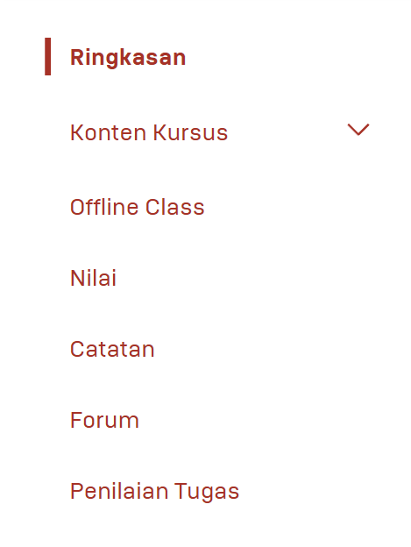

Slide 30
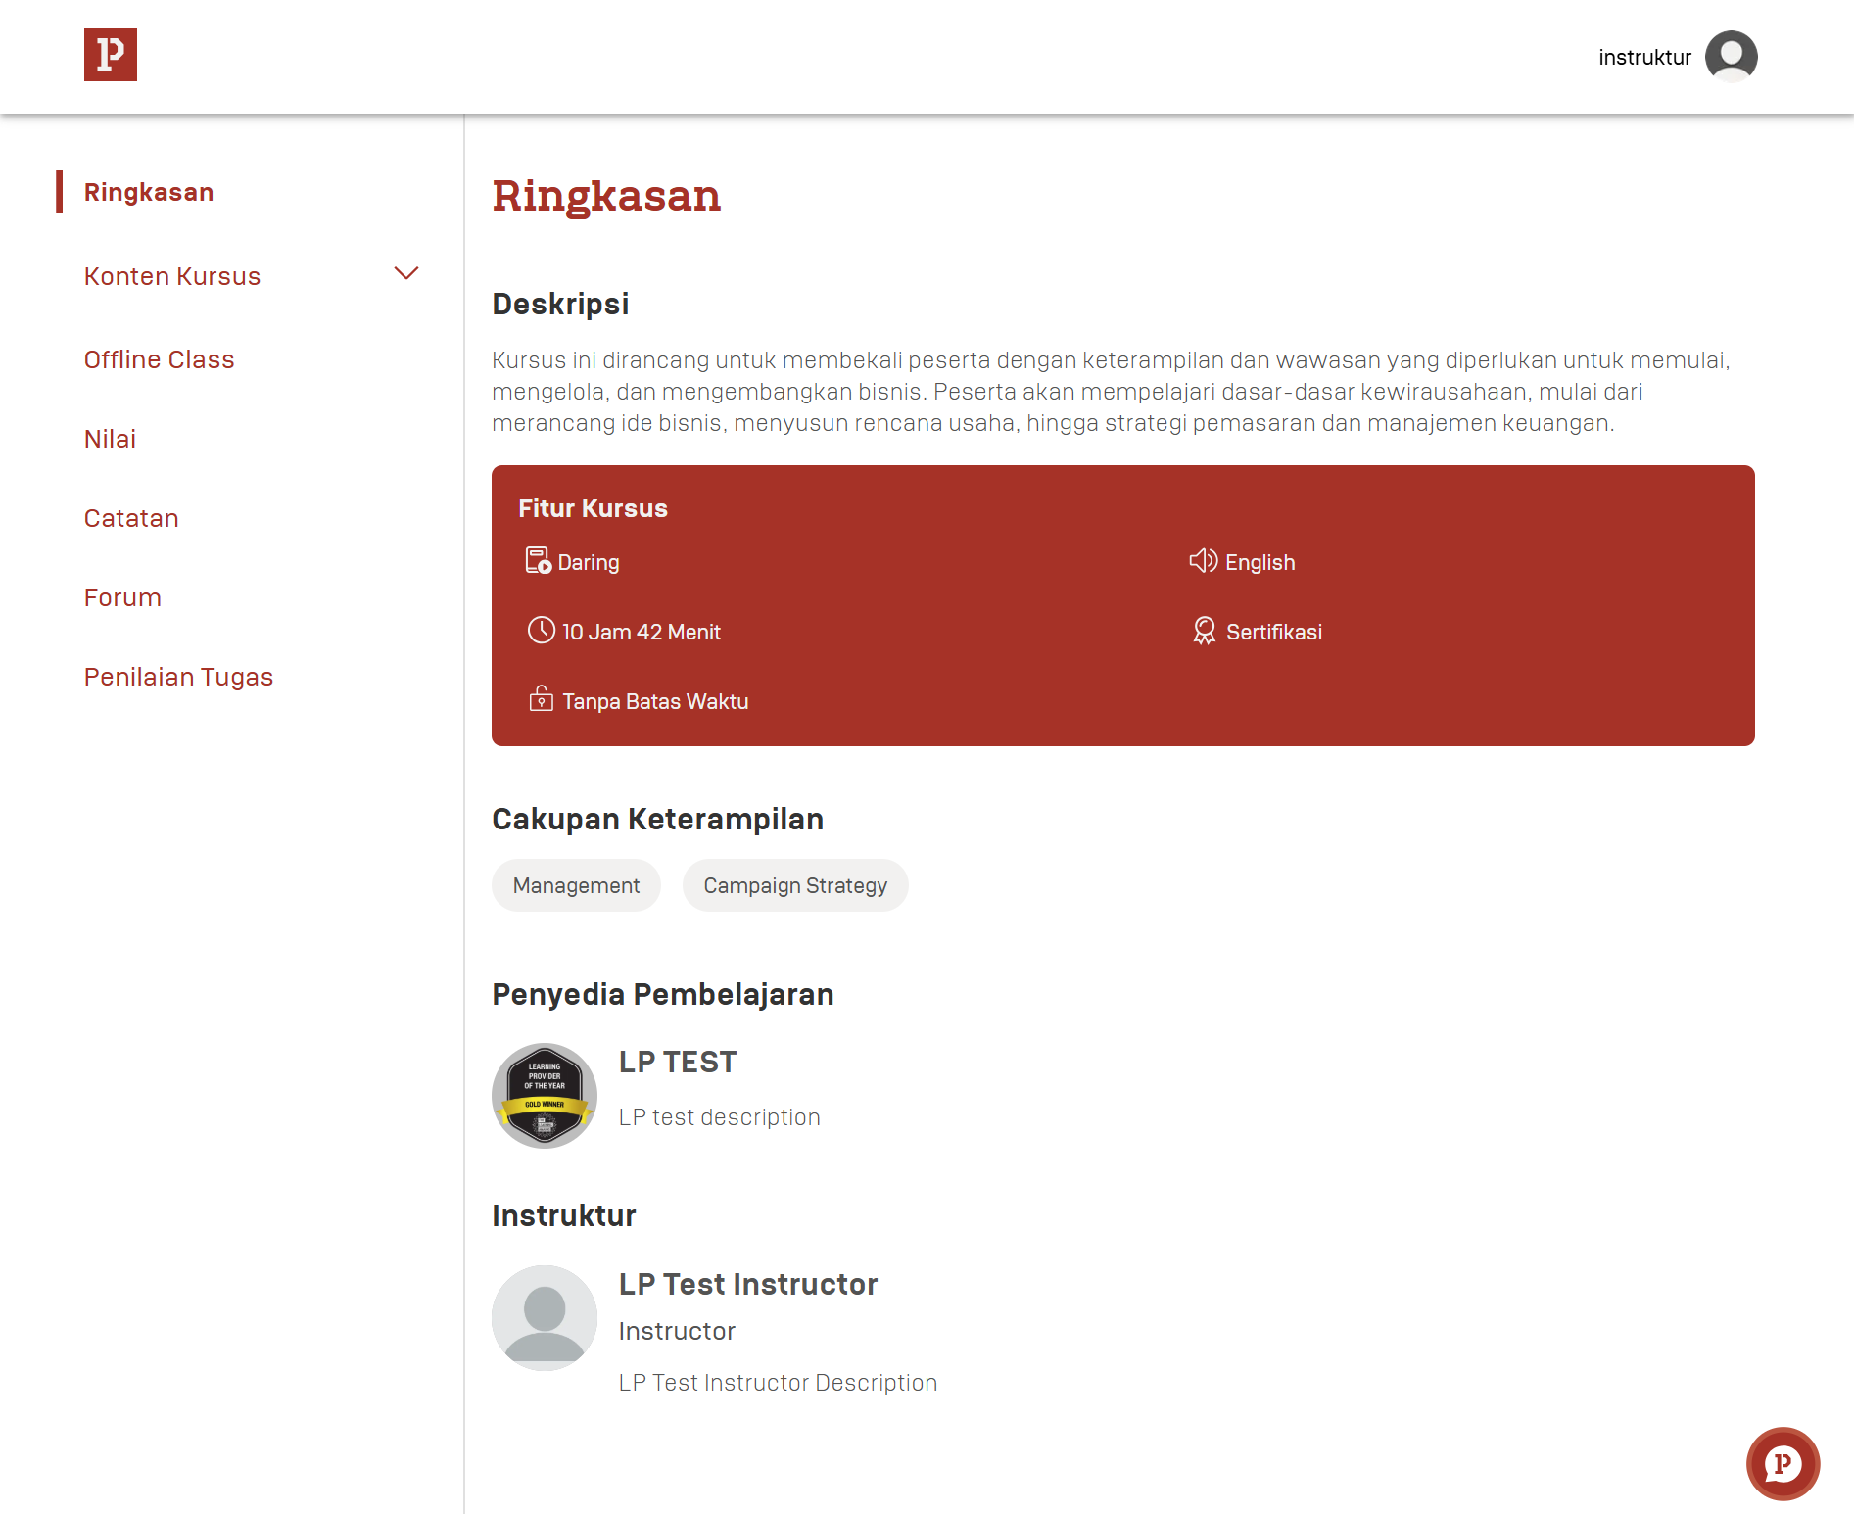

Slide 31
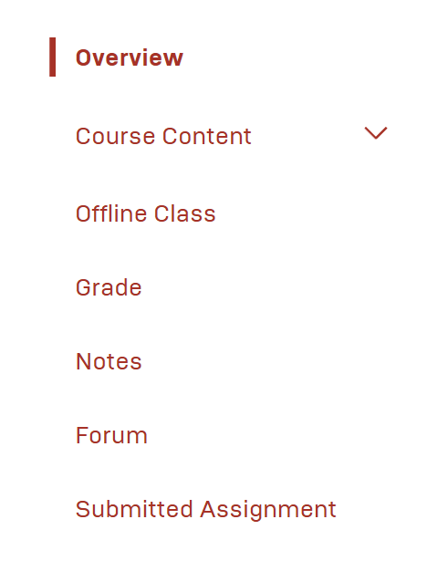

Slide 32
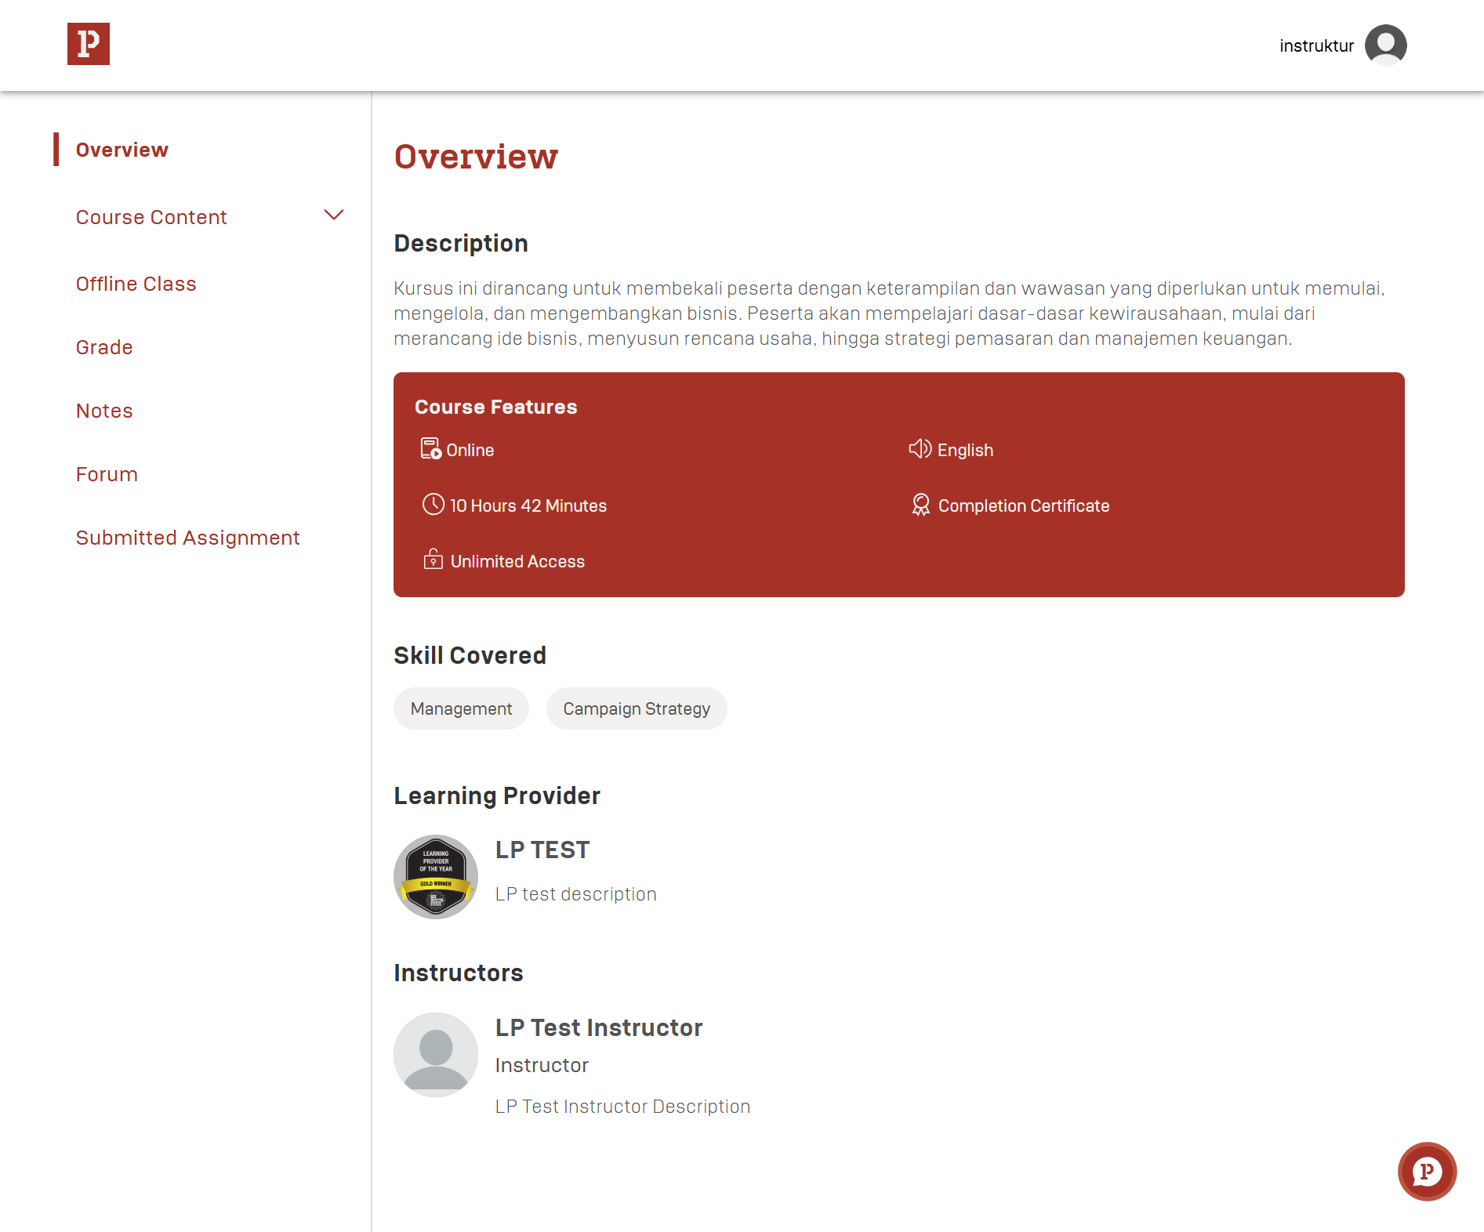

Slide 33
Skills (Instructor)
Content Material

Slide 34
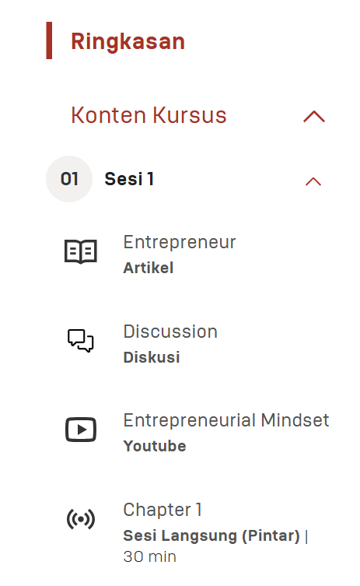

Slide 35
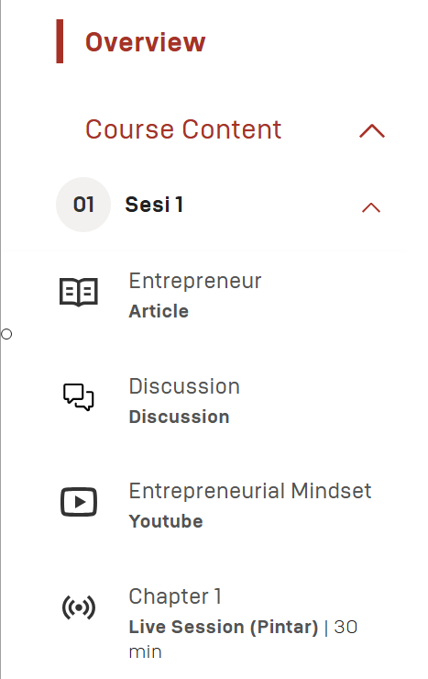

Slide 36
Skills (Instructor)
Article

Slide 37
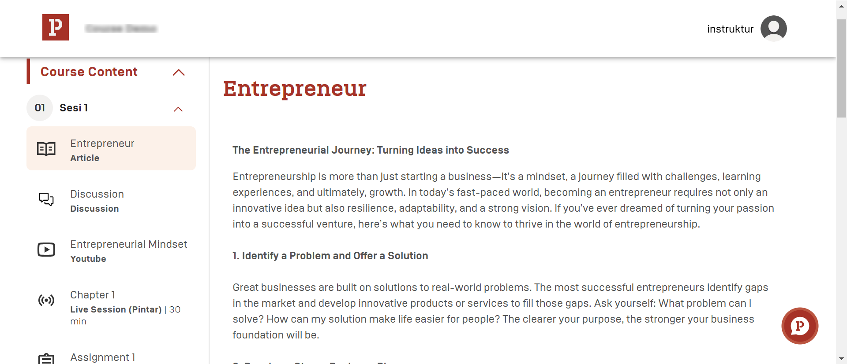

Slide 39
Skills (Instructor)
Assignment

Slide 40
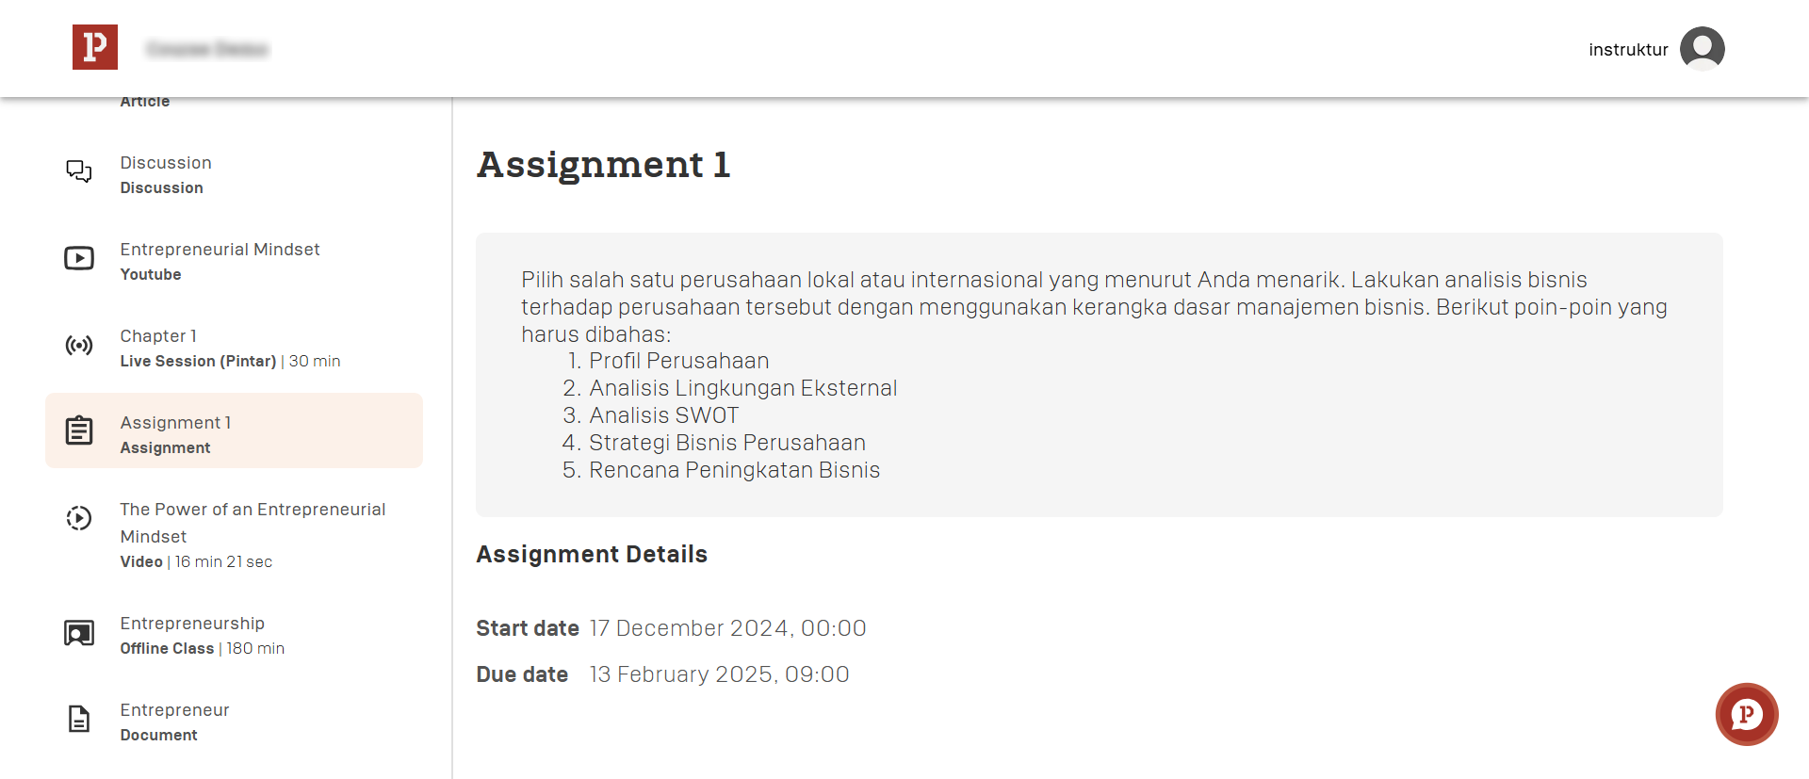

Slide 43
Skills (Instructor)
Discussion

Slide 44
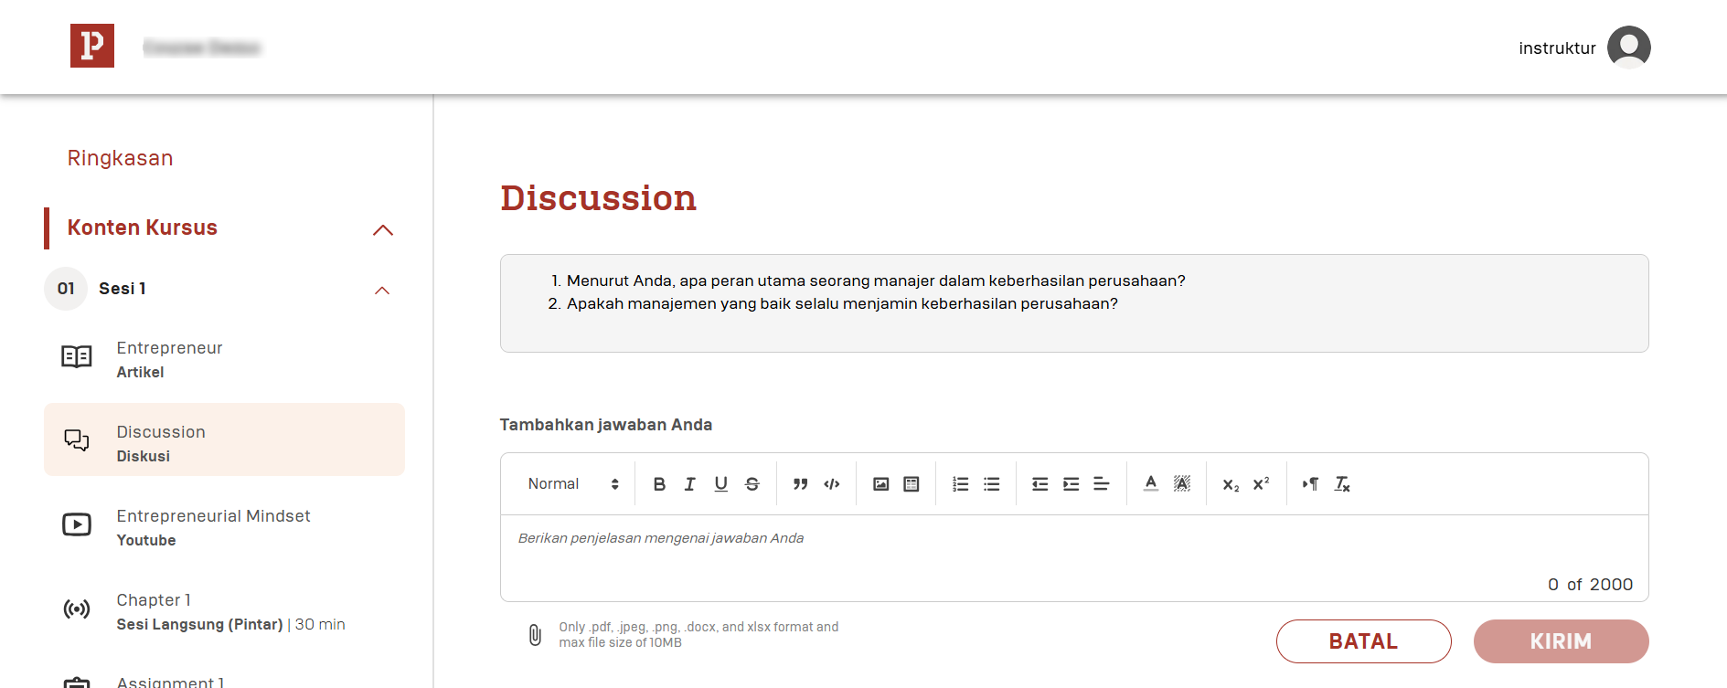
1
2
3

Slide 45
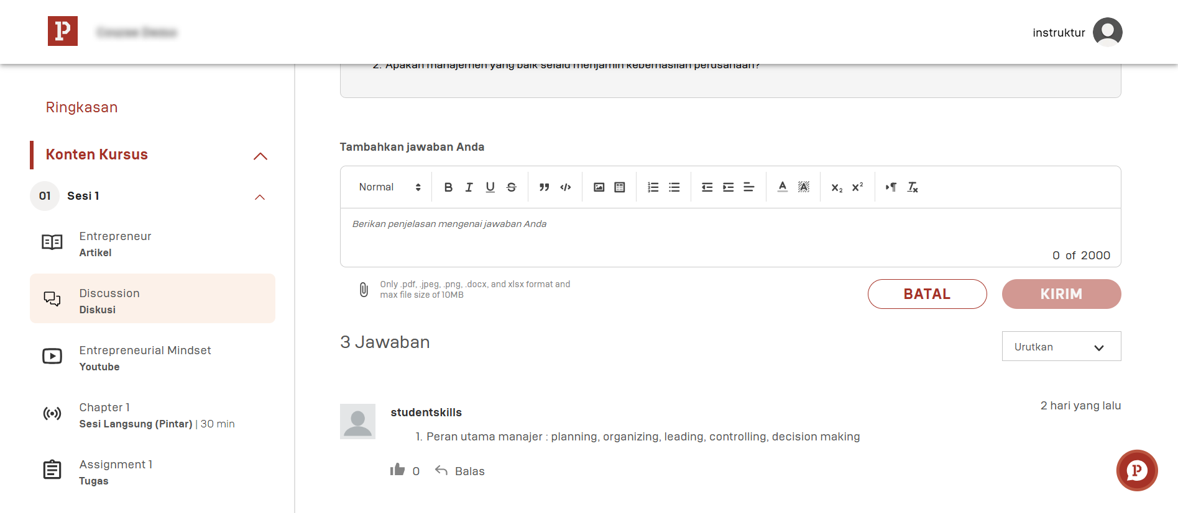

Slide 46
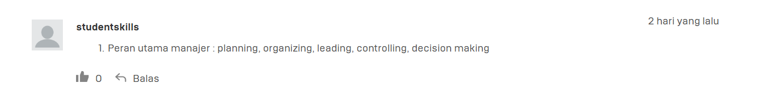
3
1
2

Slide 47
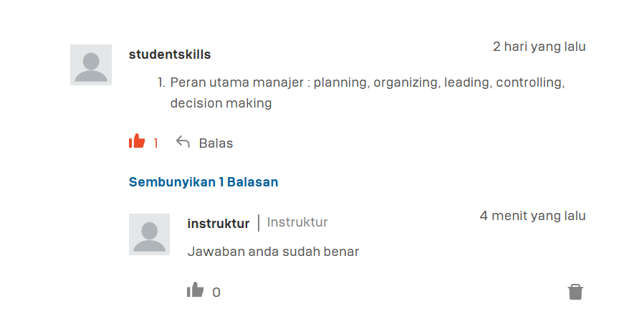

Slide 48
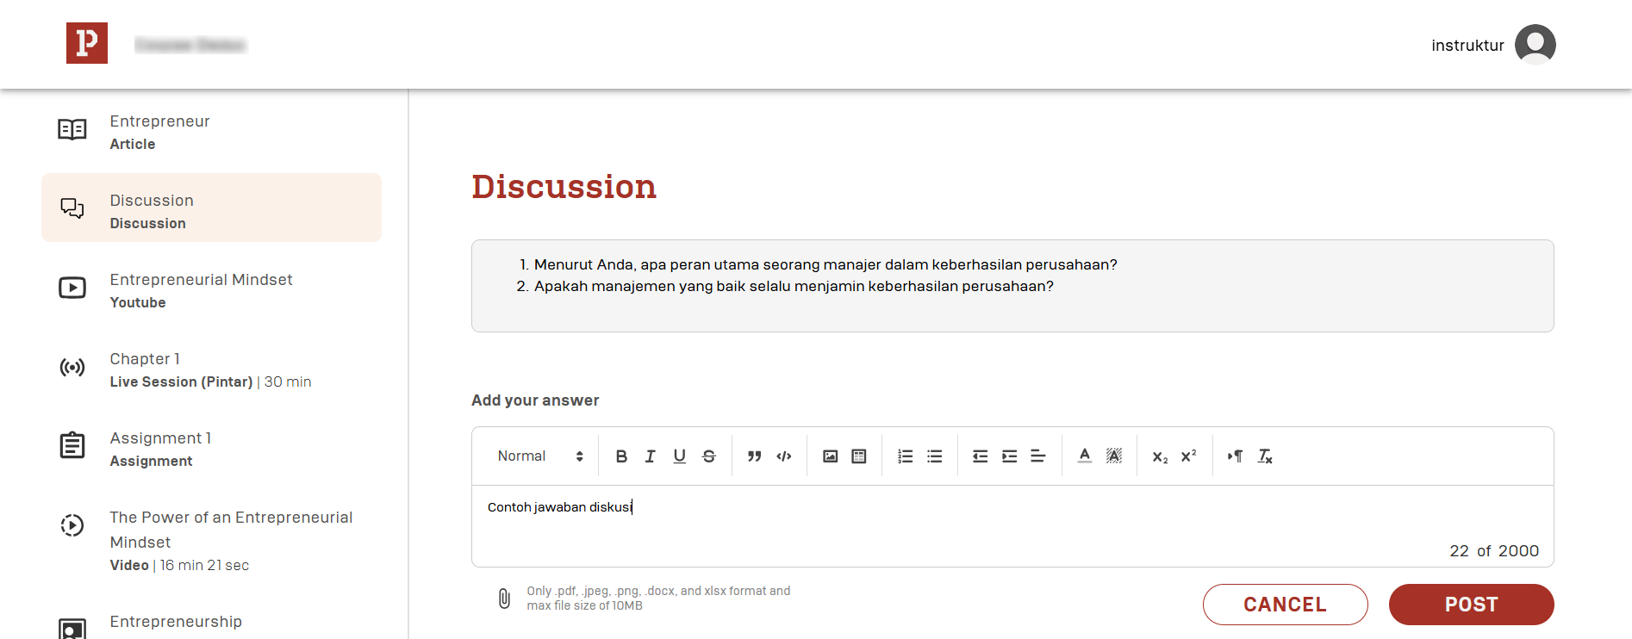
1
2
3

Slide 49
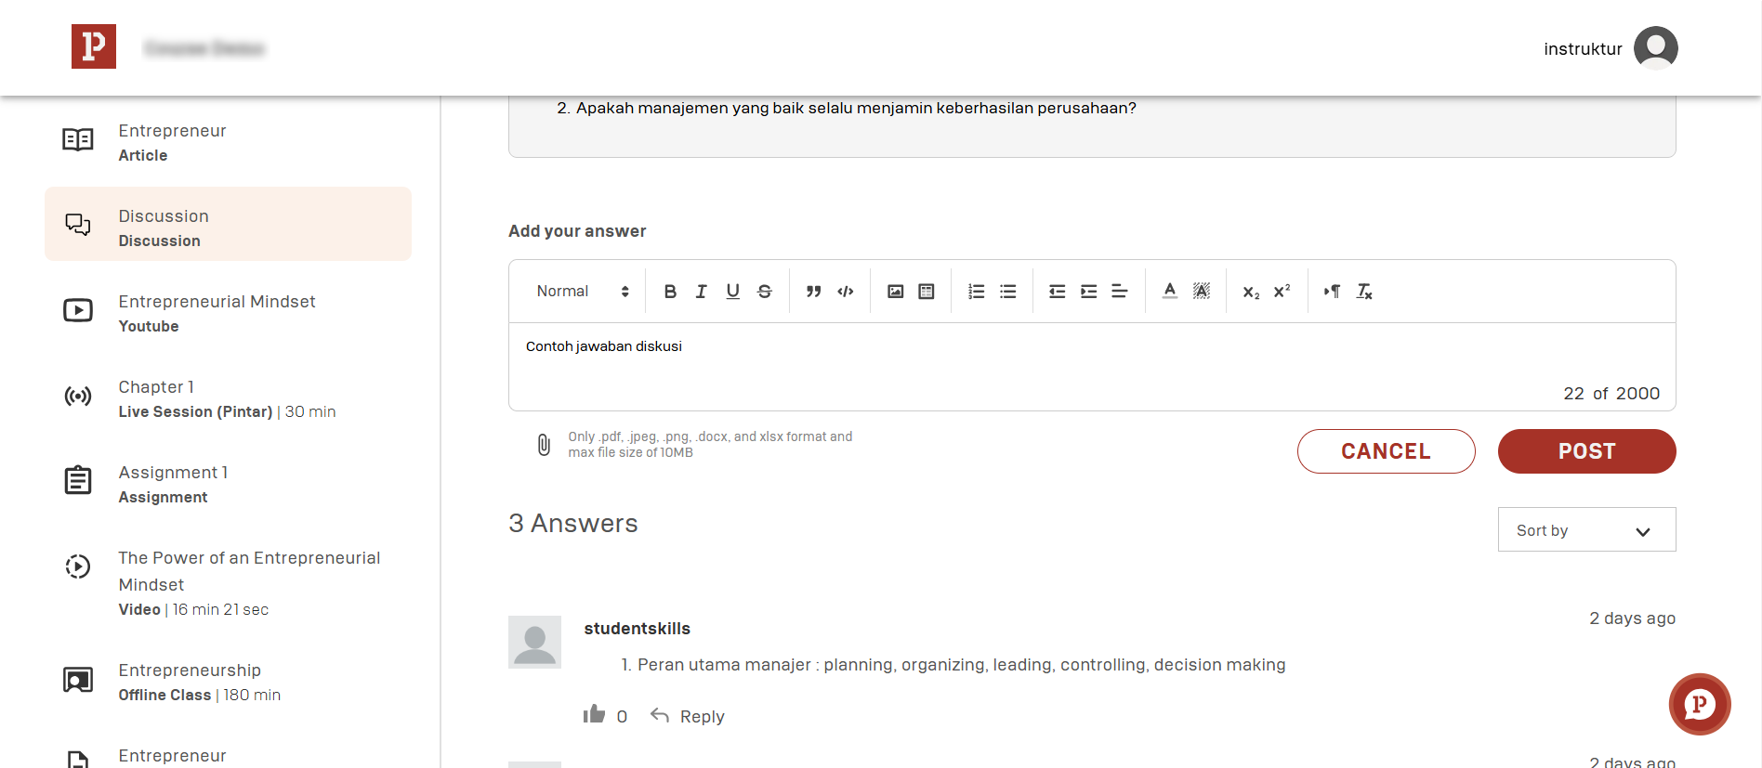

Slide 50
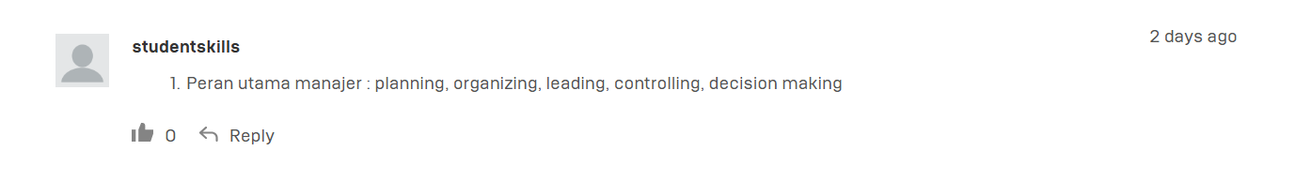
3
1
2

Slide 51
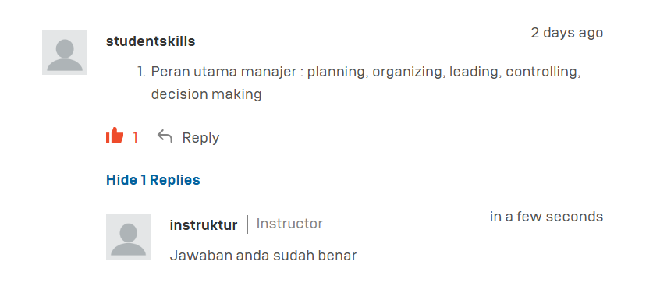

Slide 52
Skills (Instructor)
Document

Slide 53
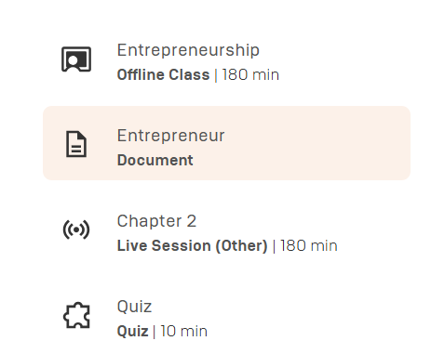

Slide 54
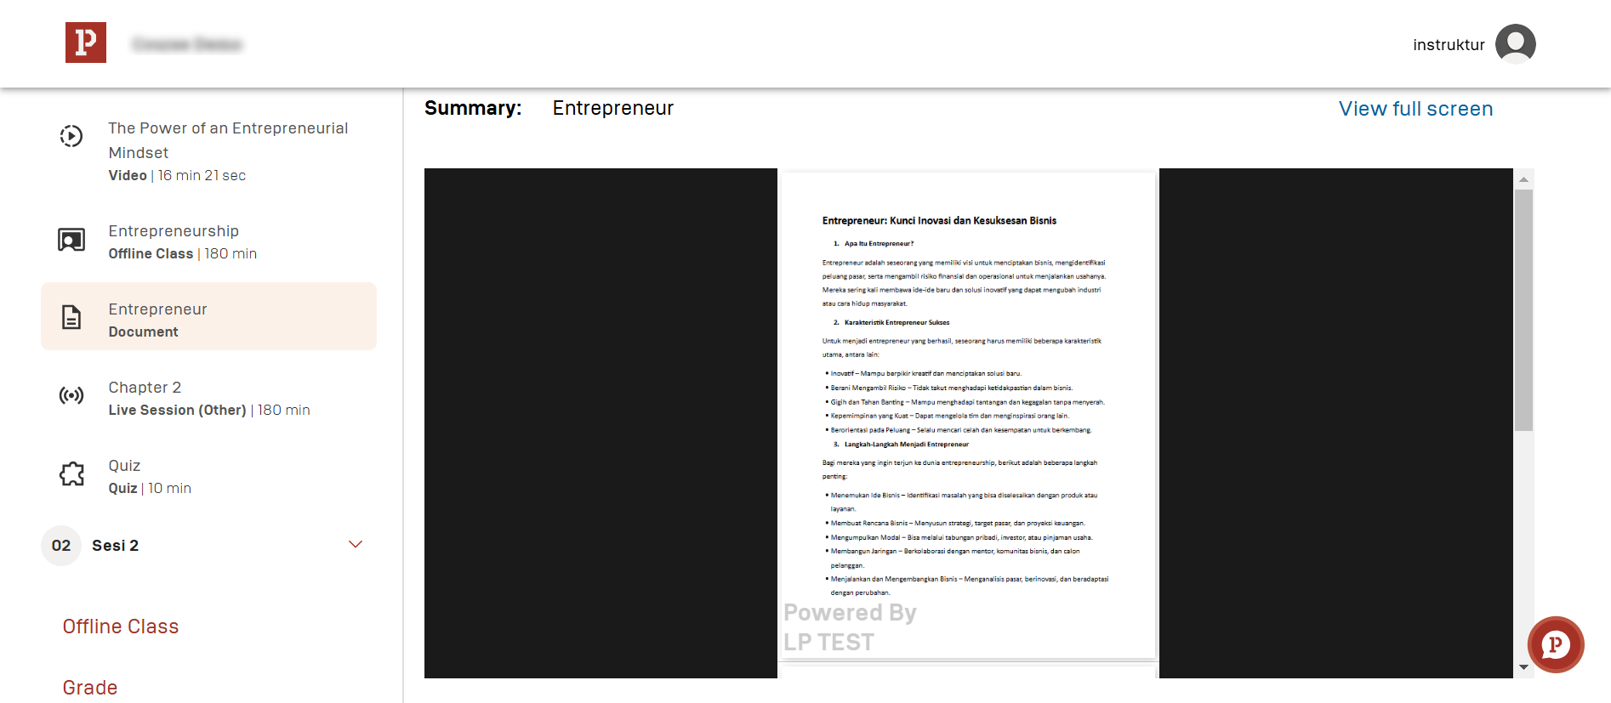

Slide 55
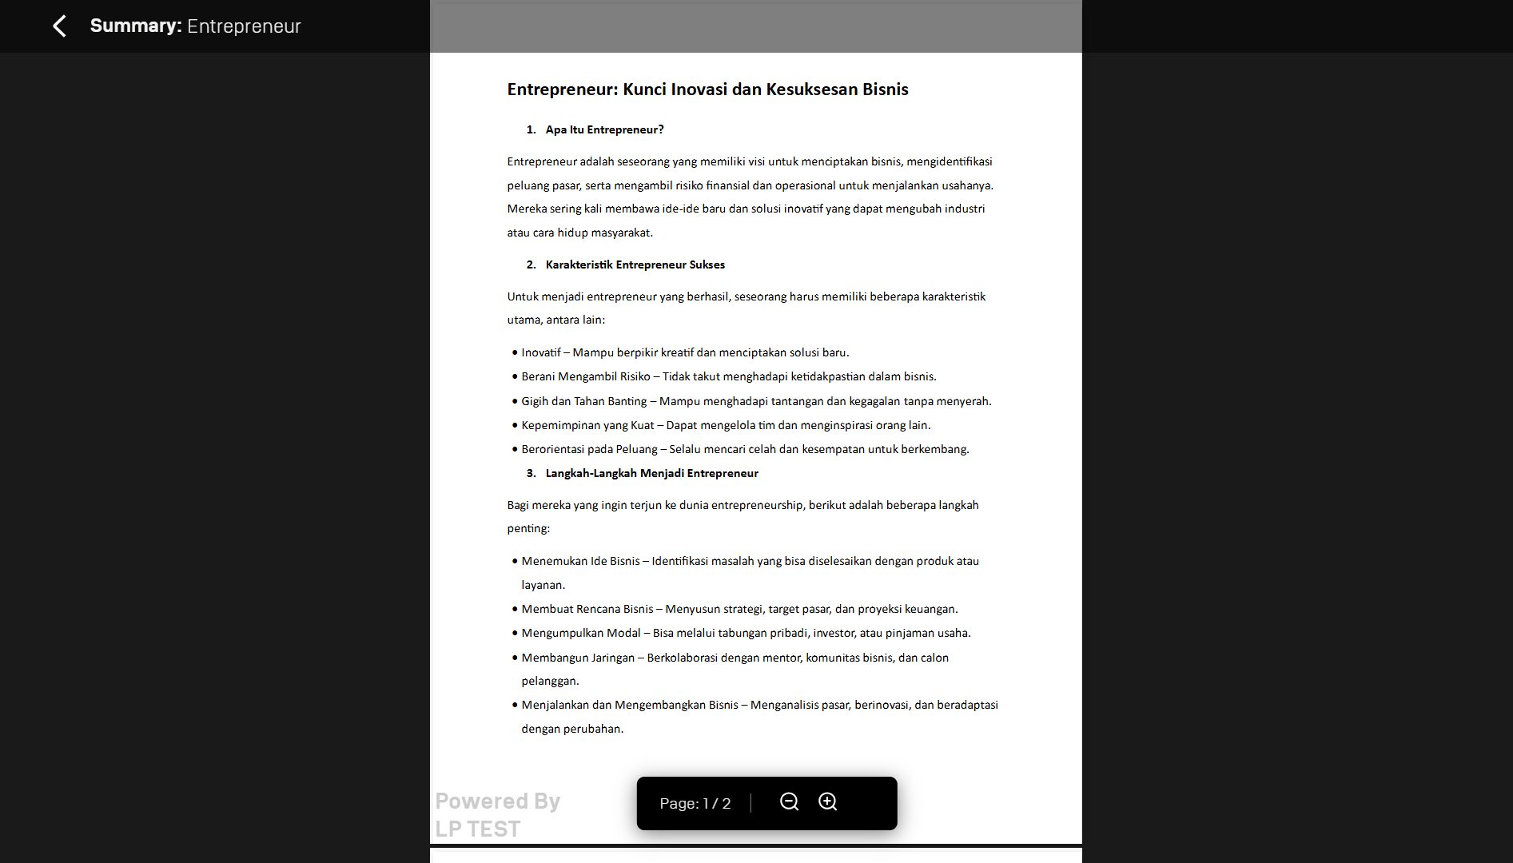

Slide 56
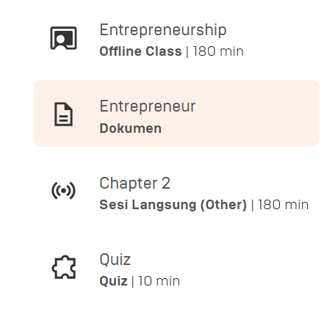

Slide 57
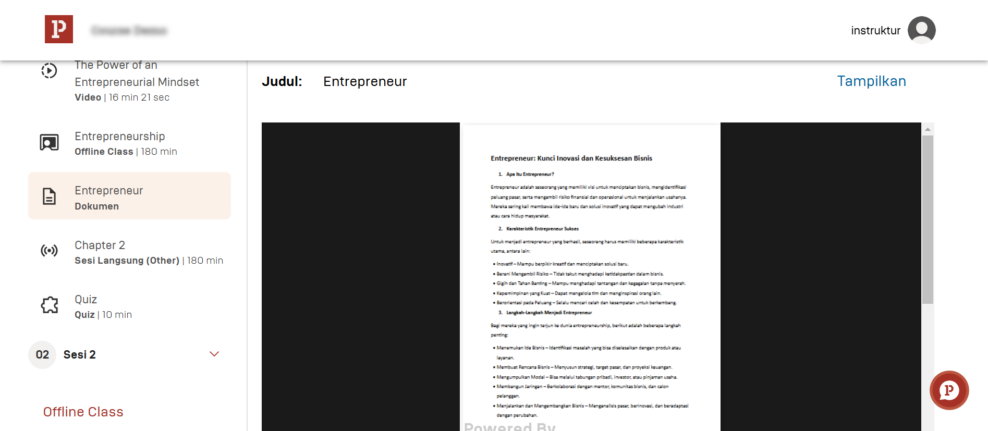

Slide 58
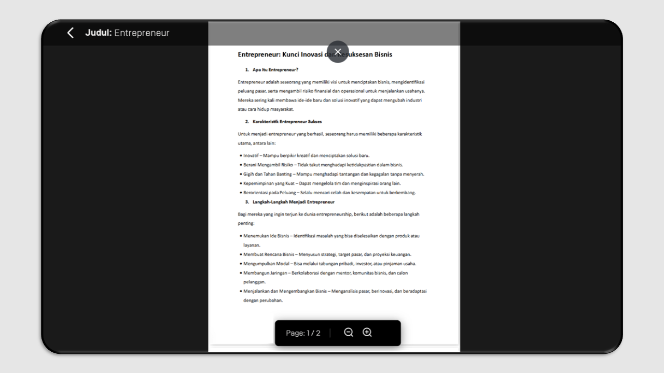

Slide 59
Skills (Instructor)
Video

Slide 60
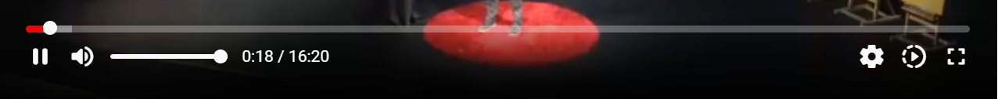
2
5
1
3
4
6

Slide 61
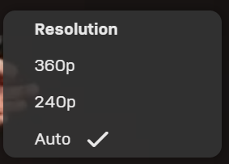

Slide 62
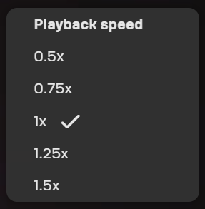

Slide 63
Skills (Instructor)
Quiz

Slide 64
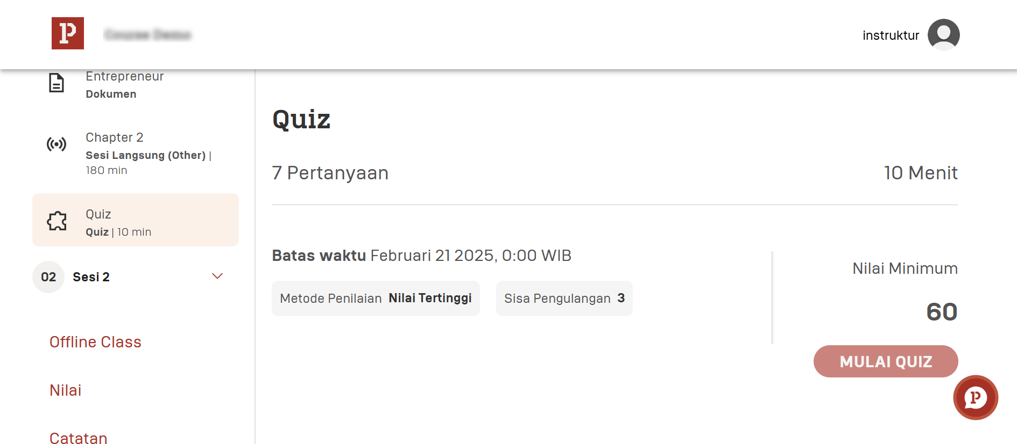

Slide 65
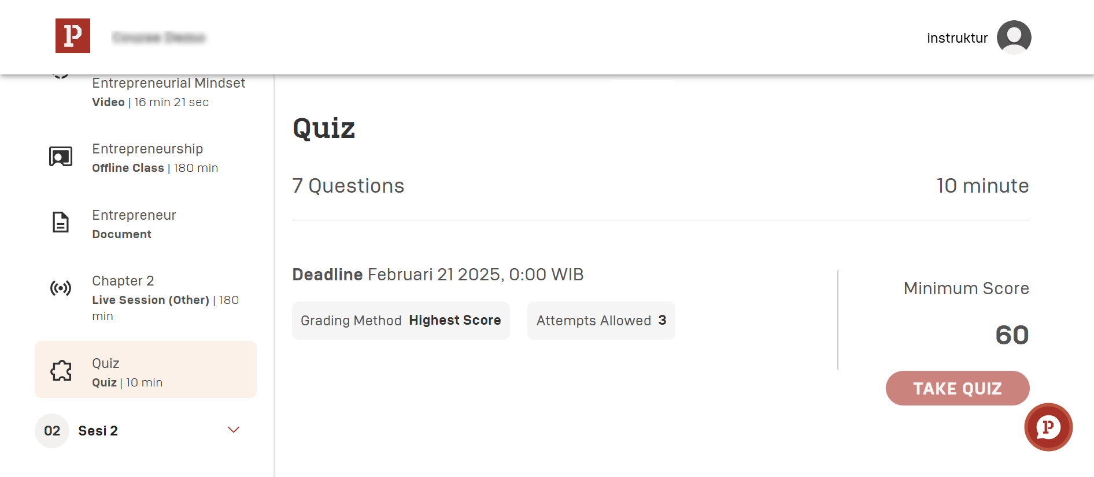

Slide 66
Skills (Instructor)
49 Grade

Slide 67
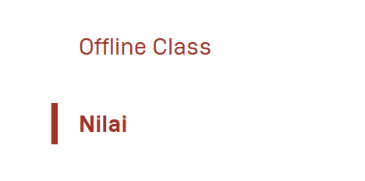

Slide 68
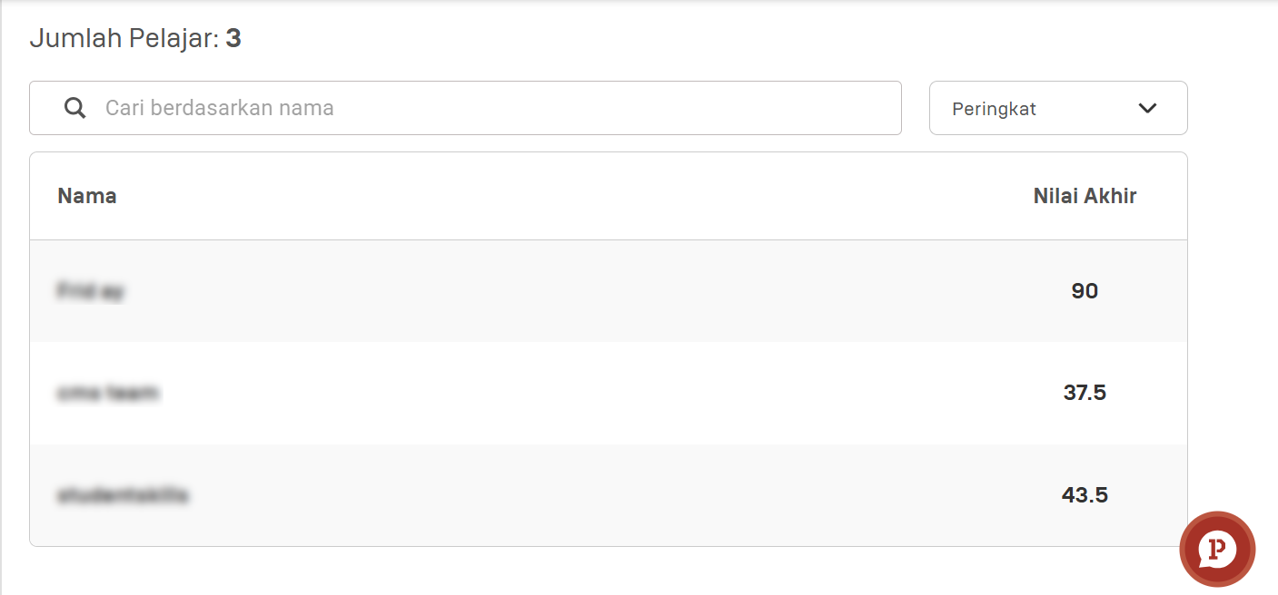

Slide 69
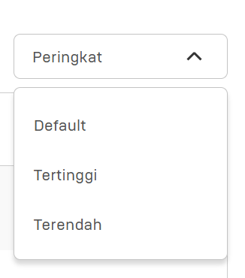

Slide 70
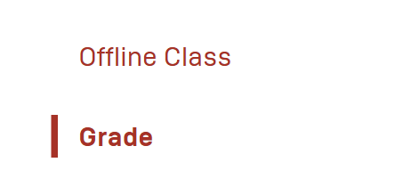

Slide 71
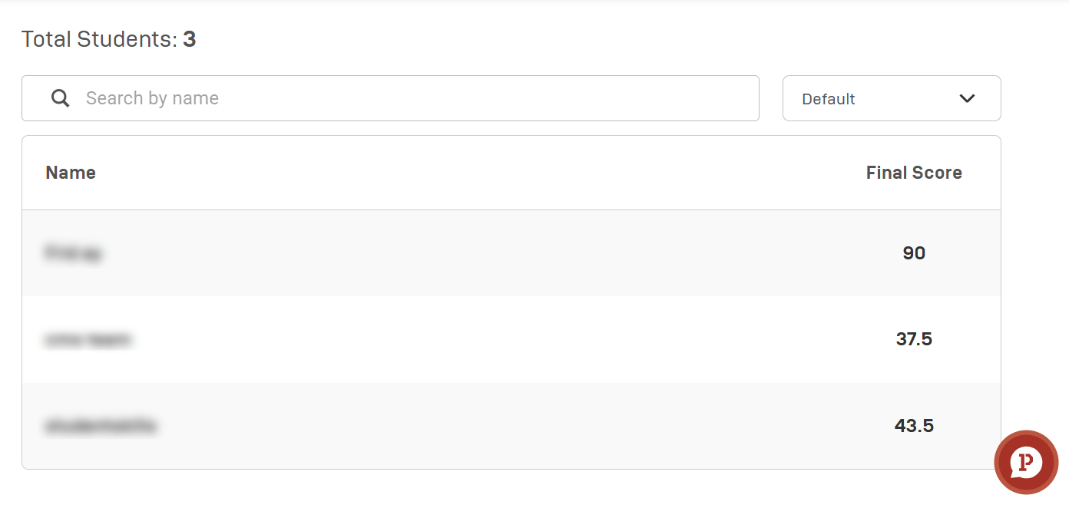

Slide 72
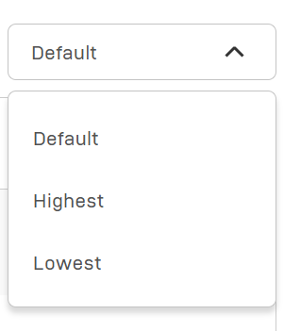

Slide 73
Skills (Instructor)
54 Submitted Assignment

Slide 74


Slide 75


Slide 76

a
b
c
d
e

Slide 77


Slide 78


Slide 79


Slide 80


Slide 81


Slide 82

a
b
c
d
e

Slide 83


Slide 84


Slide 85


Slide 86
Skills (Instructor)
43 Youtube

Slide 87


Slide 88


Slide 90


Slide 91


Slide 92


Slide 93
Skills (Instructor)
44 Offline Class

Slide 94


Slide 95


Slide 96


Slide 97


Slide 98


Slide 99


Slide 100


Slide 101


Slide 102


Slide 103


Slide 105
Skills (Instructor)
46 Live Session (Pintar)

Slide 106


Slide 107

2
1
3
4

Slide 108


Slide 109


Slide 110


Slide 111


Slide 112


Slide 113

2
1
3
4

Slide 114
Skills (Instructor)
45 Live Session (Other)

Slide 115


Slide 116



2
1
3
4

Slide 117


Slide 118


Slide 119


Slide 120


2
1
3
4

Slide 121


Slide 122
Skills (Instructor)
50 Notes

Slide 123


Slide 124


Slide 125


Slide 126


Slide 127
Skills (Instructor)
52 Forum

Slide 128


Slide 129


Slide 130


Slide 131


Slide 132


Slide 133


Slide 134


Slide 135


Slide 136
Skills (Instructor)
51 Comments

Slide 137


Slide 138


Slide 139
Skills (Learner)
Sertifikat

Slide 140

a
b

Slide 141


Slide 142


Slide 143

a
b
c

Slide 144

a
b

Slide 145


Slide 146


Slide 147
Skills (Instructor)
53 Offline Class (summary all offline class in that courses)

Slide 148


Slide 149


Slide 150
Skills (Instructor)
32 Unfinish Grading

Slide 151


Slide 152


Slide 153


Slide 154


Slide 155


Slide 156


Slide 157


Slide 158


